Slide 1


Evaluation of Primary Studies
DEPH 312 Principles of Scientific Evidence
Talal Alshihayb ^{BDS, DScD}
Diplomate, American Board of Dental Public Health
Assistant Professor
Department of Preventive Dental Science, College of Dentistry, King Saud bin Abdulaziz University for Health Sciences
Department of Health Policy and Health Services Research, Henry M. Goldman School of Dental Medicine, Boston University
January 18, 2024
shihaybt@ksau-hs.edu.sa

Slide 2
Recap
Study tasks
Measures of disease occurrence
Measures of association
Study designs
Validity and precision
Random and systematic errors in research
Causality and causal effects
Variables and their description
Measures of central tendency and dispersion
Types of distributions and the theoretical distribution
Inferential statistics (p-values and confidence intervals)
Sampling

Slide 3


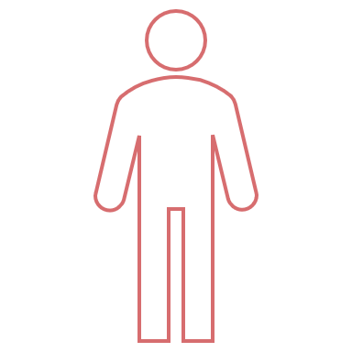

Sampling
What is it?
Why?
To reduce costs
To make study feasible
To save time

Slide 4
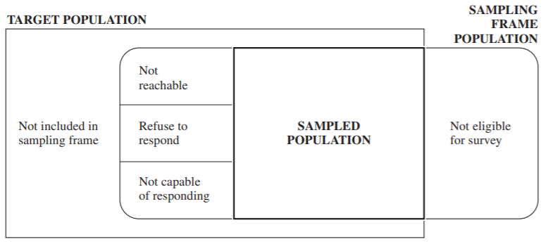
Lohr SL. Sampling: design and analysis. Nelson Education; 2009 Dec 9.

Slide 5


Sampling types
Probability sample
Probability of each element/unit getting selected is known (random)
Can yield a representative sample
E.g., assume KSAUH-HS dental students are a total of 200 and current D3 male students are 57 then probability of a male D3 student getting selected is 57/200=0.285
Non-probability sample
Probability of being selected is not known (based on human judgement)
Cannot yield a representative sample
E.g., number of D3 male students and/or total students is(are) not known. Ask faculty to try their best to select D3 students

Slide 6
Sampling types
Probability sampling
Simple random
Stratified
Cluster
Systematic random sample (technically a form of cluster sample)
Multistage (complex design)
Non-probability sampling
Purposive
Quota
Chunk
Snowball
Aday LA, Cornelius LJ. Designing and conducting health surveys: a comprehensive guide. John Wiley & Sons; 2006 Apr 14.

Slide 7


Sampling depends on study task
Descriptive
Representativeness is important
Causal
Debates about representativeness
Not required for internal validity
Some say required for external validity (which is tailored to your target population)
A new concept called target validity combines both internal and external and need representativeness of effect measure modifiers

Slide 8

LECTURE LEARNING OUTCOMES OF EACH OF THE DIDACTIC SESSIONS
REFERENCE:
Chapters 5-7 in Westreich, Daniel. Epidemiology by Design. Oxford University Press. Kindle Edition
LECTURE LEARNING OUTCOMES:
Assess cross-sectional studies.
Assess case-control studies.
Assess cohort studies.
Assess randomized clinical trials.

Slide 9
What are primary studies?

Slide 10
Study designs
Descriptive task
Causal task
Case reports
Cohort
(longitudinal)
Observational
Interventional/experimental
Case series
Cross-sectional
Case-crossover
Cross-sectional
Randomized clinical trials
Ecological
Cohort
(longitudinal)
Case-control

Slide 11
What do we mean by evaluation?

Slide 12
The goal is to correctly estimate
For descriptive task
Measure of disease occurrence:
Prevalence
Incidence
For a predictive task
Mean squared error
Root mean squared error
Sensitivity
Specificity
Predictive value (positive or negative)
Area under the curve (ROC)
For a causal task
Measures of disease association:
Difference scale (risk difference, rate difference, time difference, etc.)
Ratio scale (risk ratio, rate ratio, odds ratio, time ratio, etc.)

Slide 13
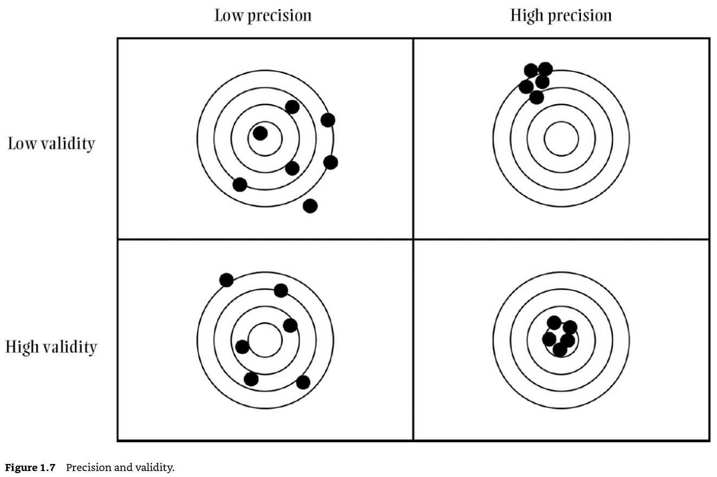
Westreich D. Epidemiology by design: a causal approach to the health sciences. Oxford University Press; 2019 Oct 16.

Slide 14
Errors in research
1
Random (precision)
Affects measures of dispersion (variance/standard deviation/range)
May affect point estimates (prevalence/incidence/effect size e.g., risk difference)
Systematic (validity)
Affects point estimates (prevalence/incidence/effect size e.g., risk difference)
What do we mean by this?
Difference between true causal effect and associational effect estimated from data
Structural reasons
2

Slide 15
Descriptive studies
Selection bias
Measurement bias
Misclassification bias (categorical)
Information bias
Hernán MA, Hsu J, Healy B. A second chance to get causal inference right: a classification of data science tasks. Chance. 2019 Jan 2;32(1):42-9.

Slide 16


Descriptive studies
Outcome
Selection bias
Participation
Prevalence of disease in population
12/40=30%
Prevalence of disease in sample
2/16=12.5%
Convenience sample

Slide 17



Internet access
77% out of total population in 2017 (Ministry of communications and Information Technology)
94% out of study participants aged 12-65 years in 2016 (Communications and Information Technology Commission)
96% in 2019
93% in another source in 2020
Reasons for not using internet among study participants aged 12-65 years who did not use internet in past 6 months in 2016 (Communications and Information Technology Commission)
Do not know how to use it 51%
Do not know uses of internet 17%
Family does not allow its use 17%
Do not know internet 15%
Do not know how to subscribe 12%
Not available 10%
Cannot afford it 9%
If you would like to know the knowledge of the Saudi population and you distribute a questionnaire online
What do you think would happen here?
https://www.citc.gov.sa/ar/reportsandstudies/studies/Documents/PublicIndividualReport2016V5_Ar.pdf
https://www.mcit.gov.sa/ar/open-data
https://data.worldbank.org/indicator/IT.CEL.SETS?locations=SA
https://datareportal.com/reports/digital-2020-saudi-arabia

Slide 18

Descriptive studies
Measurement bias
Misclassification bias (categorical)
Information bias
Measuring weight when the pin is placed at 5 kilos instead of 0
What do you think would happen here?

Slide 19

Descriptive cross-sectional study
I want to know the prevalence of lung cancer among the Saudi population in the year 2022
I need a list of all Saudis (census)
Invite all Saudis to the study (not feasible; so take a random sample from the list)
Measure the disease/outcome (lung cancer in this case)
Calculate prevalence (or prevalence odds in case the total population is not known)
Dependent variable
Outcome

Slide 20
Descriptive cross-sectional study
Was the sample taken randomly (selection bias)? How was it accounted for?
Was there non-response? How was it accounted for?
Were the outcome and/or covariates accurately measured (measurement bias)? How were they accounted for?
Was there sample size calculation? Was the sample size achieved?

Slide 21
Descriptive cohort study
I want to know the incidence of lung cancer among the Saudi population after following them for 1 year in 2022
I need a list of all Saudis (census)
Invite all Saudis to the study (not feasible; so take a random sample from the list)
Measure the disease/outcome (lung cancer in this case) at baseline (time 0)
Exclude those who already have disease/outcome (lung cancer) at baseline
Follow people at risk for developing disease (lung cancer) for 1 year
Calculate incidence proportion/risk (or incidence rate or incidence odds) of developing lung cancer after 1 year
Only those without lung cancer at baseline (at risk for developing lung cancer)
Dependent variable
Or Outcome
Time 0
Baseline
1 year

Slide 22
Descriptive cohort study
Was the sample taken randomly (selection bias)? How was it accounted for?
Was there non-response at or after baseline? How was it accounted for?
Were the outcome and/or covariates accurately measured (measurement bias)? How were they accounted for?
Was there sample size calculation? Was the sample size achieved?

Slide 23









Potential explanations of an association in Causal studies
Systematic errors
1
2
3
4
5
6
Random error
Sharing a common cause
(confounding bias)
Conditioning on a common effect
(selection bias)
Measurement error
(measurement bias)
Reverse causation
Causal

Slide 24


Randomized clinical trials (RCTs)
Independent variable
Exposure
Only
Dependent variable
Outcome
Time 0
Baseline
Time

Slide 25
Randomized clinical trials (RCTs)
How did the randomization occur?
Was there a concealment of the randomization?
Was the assignment blinded?
How was the baseline balance of the covariates between the intervention groups? (might indicate fraud or problems with randomization)
Was there confounding after baseline? How was it accounted for?

Slide 26
Randomized clinical trials (RCTs)
Was there differential loss to follow-up between the intervention groups (selection bias)? How was it accounted for?
Was there missing data? And how was it dealt with?
Was there measurement bias of the exposure, outcome, or covariates? How was it accounted for?
Was compliance measured to calculate the per-protocol effect?
Was there proper sample size calculation based on identifying a minimal effect of interest? Was the sample size achieved?

Slide 27
Randomized clinical trials (RCTs)
RoB 2 (Risk of Bias 2): https://www.riskofbias.info/welcome/rob-2-0-tool/current-version-of-rob-2
RoB 2 for cluster-randomized trials: https://www.riskofbias.info/welcome/rob-2-0-tool/rob-2-for-cluster-randomized-trials
Rob 2 for crossover trials: https://www.riskofbias.info/welcome/rob-2-0-tool/rob-2-for-crossover-trials
CASP (Critical Appraisal Skills Programme) for Randomised Controlled Trial Checklist: https://casp-uk.net/images/checklist/documents/CASP-Randomised-Controlled-Trial-Checklist/CASP-RCT-Checklist-PDF-Fillable-Form.pdf

Slide 28
Causal cohort study
Independent variable
Exposure
Only
Dependent variable
Outcome
Time 0
Baseline
Time

Slide 29
Causal cohort study
How was the baseline balance of the covariates between the exposure groups?
Was there confounding at or after baseline? Was it appropriately accounted for?
Was there differential baseline participation or loss to follow-up between the exposure groups (selection bias)? How were they handled?
Was there missing data? And how was it dealt with?

Slide 30
Causal cohort study
Was there measurement bias of the exposure, outcome, or covariates? How were they handled?
Was there differential measurement of the exposure with respect to outcome (ascertainment bias)?
Was there proper sample size calculation based on identifying a minimal effect of interest? Was the sample size achieved?
If a retrospective cohort, did the exposure occur before the outcome?

Slide 31
Causal cohort study
ROBINS-E (Risk Of Bias in Non-randomized Studies of Exposures): https://www.riskofbias.info/welcome/robins-e-tool
ROBINS-I (Risk Of Bias in Non-randomized Studies of Interventions): https://www.riskofbias.info/welcome/home
STROBE (STrengthening the Reporting of OBservational studies in Epidemiology): https://www.strobe-statement.org/checklists/
CASP: https://casp-uk.net/images/checklist/documents/CASP-Cohort-Study-Checklist/CASP-Cohort-Study-Checklist-2018_fillable_form.pdf

Slide 32
Case-control
Independent variable
Exposure
Dependent variable
Outcome
Time 0
Baseline
Time

Slide 33
Case-control
How was the balance of the covariates between the outcome groups?
Was there confounding at or after baseline? Was it appropriately accounted for?
Was there differential baseline participation or loss to follow-up between the exposure groups (selection bias)? How were they handled?
Were the controls selected from the same environment that would give rise to cases (selection bias)?

Slide 34
Case-control
Was there missing data? And how was it dealt with?
Was there measurement bias of the exposure, outcome, or covariates? How were they handled?
Was there differential measurement of the exposure with respect to outcome (recall bias)?
Was there proper sample size calculation based on identifying a minimal effect of interest? Was the sample size achieved?
Did the exposure occur before the outcome?

Slide 35
Case-control
ROBINS-E (Risk Of Bias in Non-randomized Studies of Exposures): https://www.riskofbias.info/welcome/robins-e-tool
ROBINS-I (Risk Of Bias in Non-randomized Studies of Interventions): https://www.riskofbias.info/welcome/home
STROBE (STrengthening the Reporting of OBservational studies in Epidemiology): https://www.strobe-statement.org/checklists/
CASP: https://casp-uk.net/images/checklist/documents/CASP-Case-Control-Study-Checklist/CASP-Case-Control-Study-Checklist-2018-fillable-form.pdf

Slide 36
Causal cross-sectional study
Independent variable
Exposure
Dependent variable
Outcome
Time

Slide 37
Causal cross-sectional study
How was the balance of the covariates between the exposure groups?
Was there confounding at baseline? Was it appropriately accounted for?
Was there differential baseline participation between the exposure groups (selection bias)? How was it handled?
Was there missing data? And how was it dealt with?

Slide 38
Causal cross-sectional study
Was there measurement bias of the exposure, outcome, or covariates?
Was there proper sample size calculation based on identifying a minimal effect of interest? Was the sample size achieved?
Did the exposure occur before the outcome?

Slide 39
Causal cross-sectional study
ROBINS-E (Risk Of Bias in Non-randomized Studies of Exposures): https://www.riskofbias.info/welcome/robins-e-tool
ROBINS-I (Risk Of Bias in Non-randomized Studies of Interventions): https://www.riskofbias.info/welcome/home
STROBE (STrengthening the Reporting of OBservational studies in Epidemiology): https://www.strobe-statement.org/checklists/

Slide 40
Systematic errors in RCTs vs observational studies
Randomization protects against baseline confounding
Randomization does not protect against
Selection bias if selection occurs after randomization
Measurement bias

Slide 41

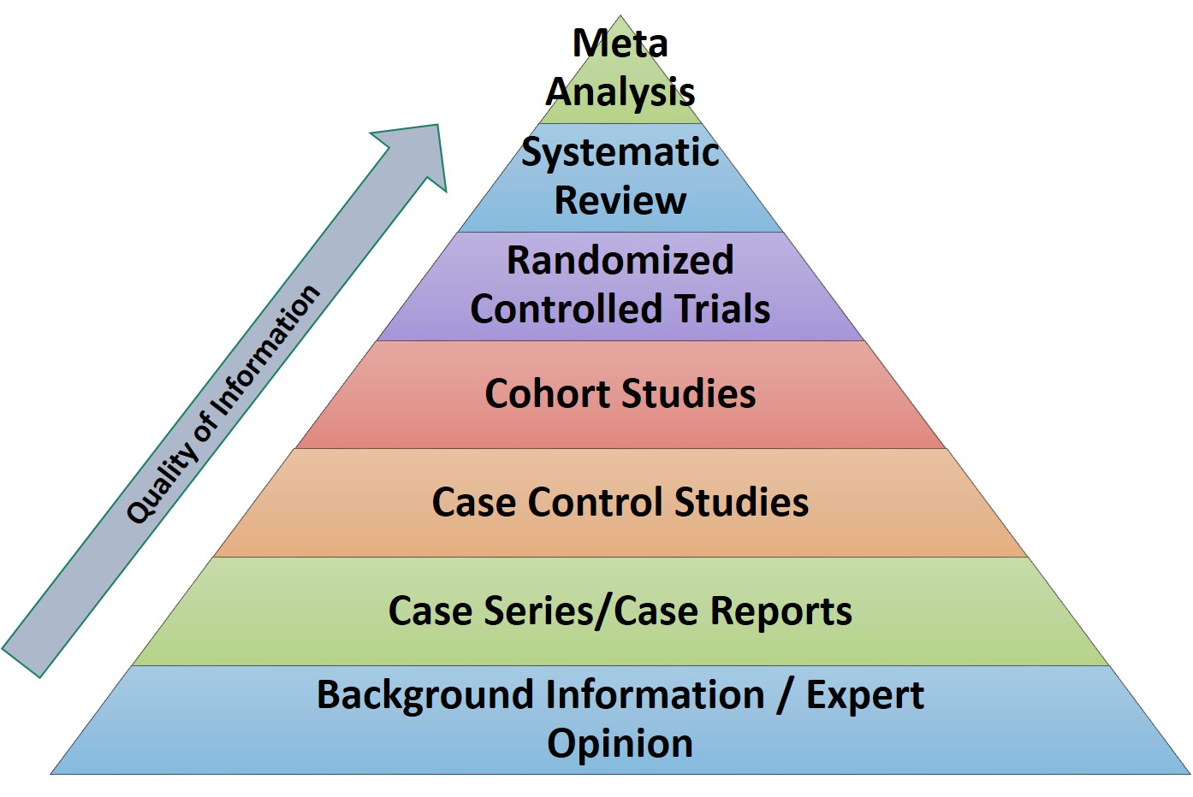
https://www.google.com/url?sa=i&url=https%3A%2F%2Flibrary.triton.edu%2Fc.php%3Fg%3D433673%26p%3D3720267&psig=AOvVaw2Gn9hmhr8Okj3uU0tuJti3&ust=1632053370437000&source=images&cd=vfe&ved=0CAsQjRxqFwoTCKD1luG-iPMCFQAAAAAdAAAAABAJ

Slide 42
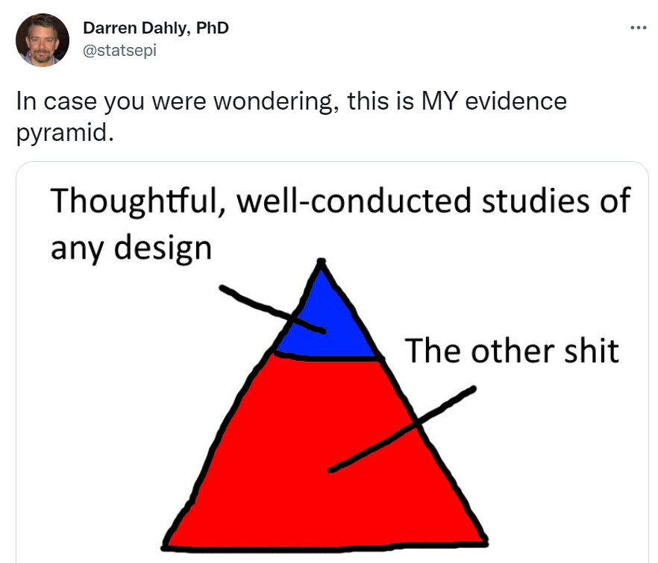

Slide 43
Validity
Internal validity
Systematic error (bias)
External validity
Generalizability (do results apply to target population?)
Transportability (do results apply to another population?)

Slide 44
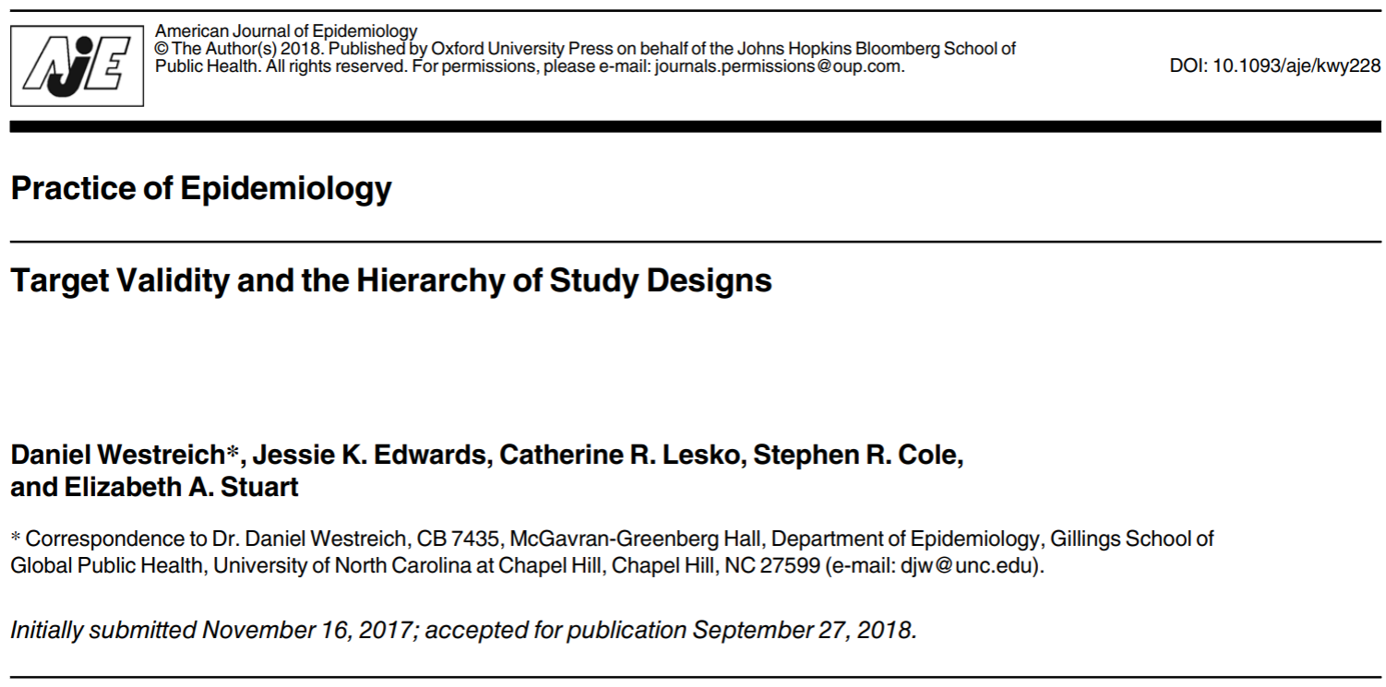

Slide 45
Any Questions?
shihaybt@ksau-hs.edu.sa

